Slide 1
An Integrated Memory and SSD Caches Management Scheme
報告者：陳宇軒、吳哲宇
指導老師：張軒彬 教授

Slide 2
Outline
Introduction
Background
Design
Evaluations
Conclusions

Slide 3
Introduction (1/3)
Motivation：
HDD is far slower than CPU
SSD is too expensive
To strike a balance between efficiency and cost, we need to combine them

Slide 4
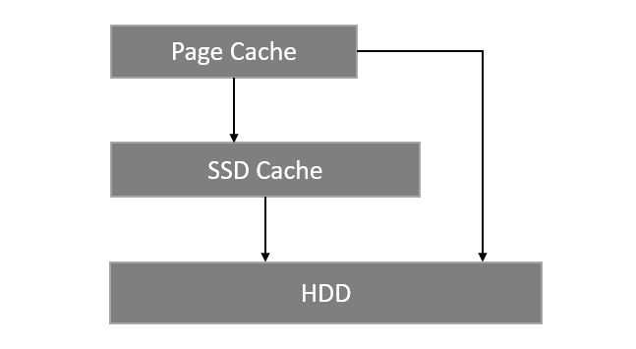
Introduction (2/3)
SSD-based Disk Cache：
Have two-tiered Cache, the first tier is Page Cache, and the second tier is SSD Cache.
But, because Page Cache and SSD Cache are managed
independently, there are some problems

Slide 5
Introduction (3/3)
Problem:
Metadata duplication:
Some metadata that maintained by Page Cache will be also maintained by SSD Cache
Double Caching:
In some situation, Page Cache and SSD Cache will cache the same data
Inaccurate/delayed Information:
SSD Cache can’t know what happened in Page Cache
Blind page cache management:
Page Cache can’t know whether data is form SSD or HDD

Slide 6
Outline
Introduction
Background
Design
Evaluations
Conclusions

Slide 7
Background (1/2)
LRU：
A Page Cache Replacement Algorithm
4
3
1
4
2
2
4
3
1
2
5
2
4
3
1
5
2
4
3

Slide 8
Background (2/2)
LARC：
A SSD Cache Replacement Algorithm
Have a ghost queue to store metadata
4
3
1
4
2
5
4
3
1
2
6
4
3
1
2
5
5
4
3
1
2
6
5
5
4
3
1
6

Slide 9
Outline
Introduction
Background
Design
Evaluations
Conclusions

Slide 10
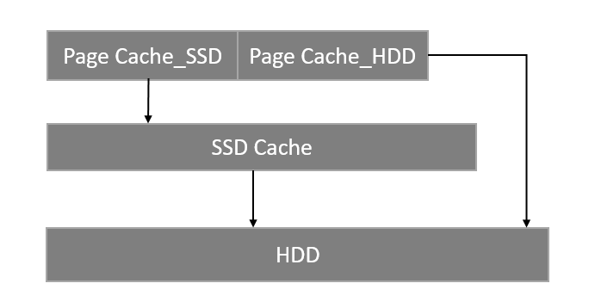
Design (1/9)
New Architecture：
Separate Page Cache to Page Cache_SSD & Page Cache_HDD
Page Cache_SSD cache data from the SSD
Page Cache_HDD cache data from the disk
- Solve the Blind page cache management problem

Slide 11
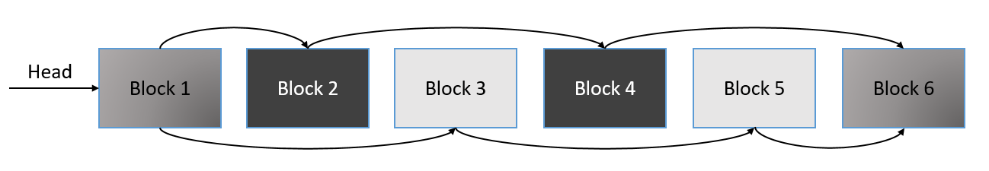
Design (2/9)
New Data Structure for Metadata：
Maintain metadata in the same structure
Both Page Cache and SSD Cache can access them
- Solve Metadata duplication and Inaccurate/delayed Information

Slide 12
Design (3/9)
Reduce Double Caching：
Because Page Cache will cache data from SSD, it is inevitable to happen
miss
Page Cache
miss
SSD Cache
HDD

Slide 13
Design (4/9)
Reduce Double Caching：
Modify cache strategy to reduce it
miss
kick
Page Cache
Page Cache
miss
SSD Cache
SSD Cache
cache
HDD
HDD

Slide 14
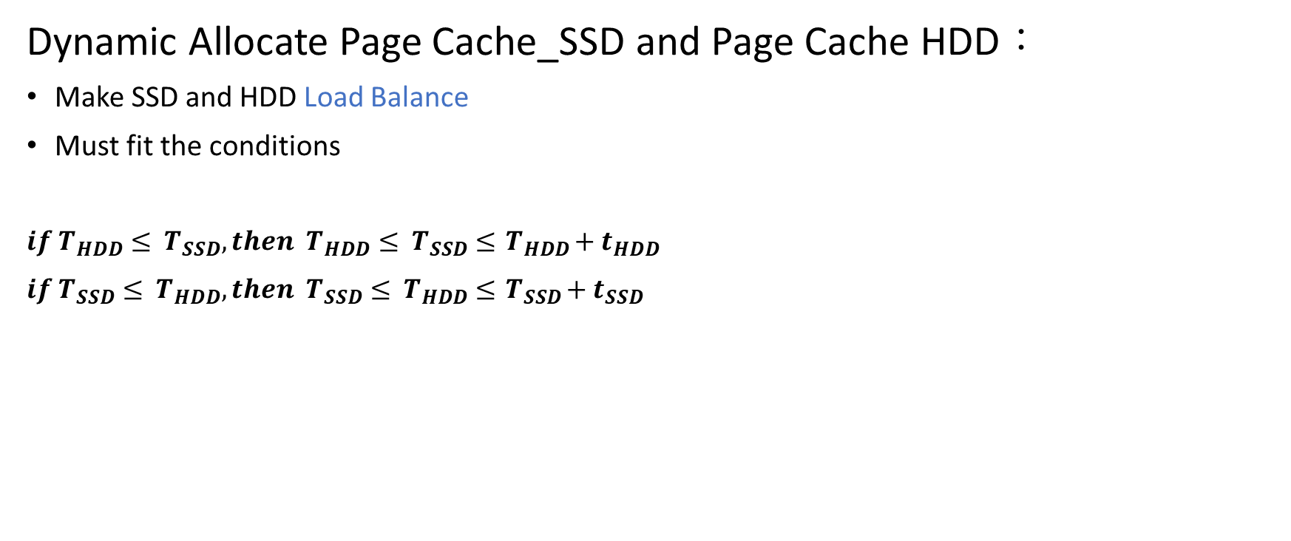
Design (5/9)
Dynamic Allocate Page Cache_SSD and Page Cache HDD：
Make SSD and HDD Load Balance
Must fit the conditions
$if{ T}_{HDD}≤ { T}_{SSD}, then { T}_{HDD}≤ { T}_{SSD} ≤{ T}_{HDD}+{ t}_{HDD}$
$if{ T}_{SSD}≤ { T}_{HDD}, then { T}_{SSD}≤ { T}_{HDD} ≤{ T}_{SSD}+{ t}_{SSD}$

Slide 15

Design (6/9)
Dynamic Allocate Page Cache_SSD and Page Cache HDD：
Separate Page Cache to several section, and record access count of each section
Example:
Page Cache_SSD
Page Cache_HDD
$${ T}_{HDD}≤ { T}_{SSD}$$

Slide 16

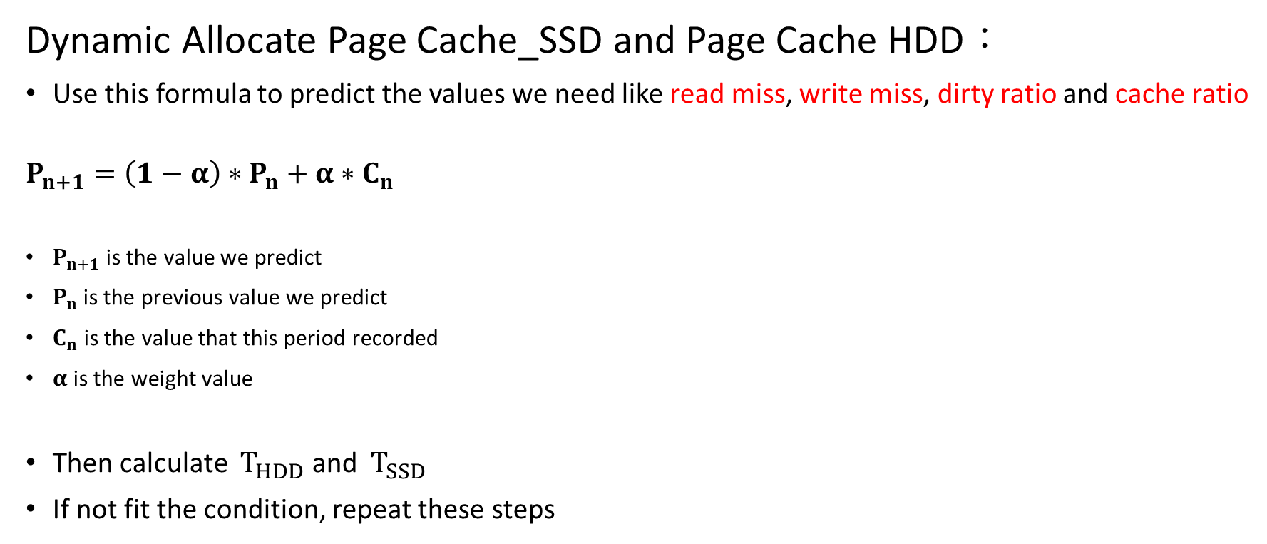
Design (7/9)
Dynamic Allocate Page Cache_SSD and Page Cache HDD：
Use this formula to predict the values we need like read miss, write miss, dirty ratio and cache ratio
$$P_{n+1}=\left(1−α\right)∗P_{n}+α∗C_{n}$$
$P_{n+1}$ is the value we predict
$P_{n}$ is the previous value we predict
$C_{n}$ is the value that this period recorded
$α$ is the weight value
Then calculate ${ T}_{HDD}$ and ${ T}_{SSD}$
If not fit the condition, repeat these steps
$$γ$$

Slide 17

Design (8/9)
Dynamic Allocate Page Cache_SSD and Page Cache HDD：
Calculate Page Cache_SSD miss penalty
read
miss
kick
Page Cache_SSD
Page Cache_HDD
If tail of Page Cache_SSD is dirty
Write SSD time
Read SSD time
hit
Write SSD time
Page Cache_SSD Dirty ratio * Write SSD time
SSD Cache
HDD

Slide 18
Design (9/9)
Dynamic Allocate Page Cache_SSD and Page Cache HDD：
Calculate Page Cache_HDD miss penalty
If tail of Page Cache_HDD will be cache to SSD
read
Write SSD time
miss
And if tail of SSD is dirty
kick
Page Cache_SSD
Page Cache_HDD
kick
Write HDD time
SSD Cache ratio *
(Write SSD time + SSD dirty ratio * Write HDD time)
Write SSD time
Read HDD time
miss
SSD Cache
kick
If will not be cache
If tail of Page Cache_HDD is dirty
Write HDD time
Write HDD time
Write HDD time
HDD
(1 - SSD Cache ratio) *
Page Cache_HDD dirty ratio * Write HDD time

Slide 19
Outline
Introduction
Background
Design
Evaluations
Conclusions

Slide 20
Evaluations (1/4)
Analysis of traces：
trace | Number of Reference | Data Size | Working Set Size | Average Inter-arrival Time
gcc | 158590 | 158590*4 KB | 785*4 KB | 0.004112 s
cscope | 1119161 | 1119161*4 KB | 19698*4 KB | 0.002120 s
multi1 | 1264590 | 1264590*4 KB | 19646*4 KB | 0.002554 s

Slide 21
Evaluations (2/4)
gcc：

Slide 22
Evaluations (3/4)
cscope：

Slide 23
Evaluations (4/4)
multi1：

Slide 24
Outline
Introduction
Background
Design
Evaluations
Conclusions

Slide 25
Conclusions
An Integrated Memory and SSD Caches Management Scheme：
To solve the problem original SSD based disk cache will have
Dynamic allocate Page Cache to Page Cache_SSD & Page Cache_HDD
Combine Page Cache and SSD Cache ‘s metadata
Modify strategy to reduce double caching

Slide 26
END
Thank for your watching

